Slide 1
The origin of genetic variation
Motivation
Evolution is a change in the genotype of the population over time. Phenotypic differences between species reflects genetic differences between species = genetic variation across species
What is the origin of genetic variation??
Ultimate Source:
MUTATION!!!!!!!!!!!!!!!!!!!!!!!!!!!!
Notes:
Focus is on Genetic variation. Phenotypic variation due strictly to variation in the environment or how different genotypes respond to different environments will be covered in later lectures.

Slide 2
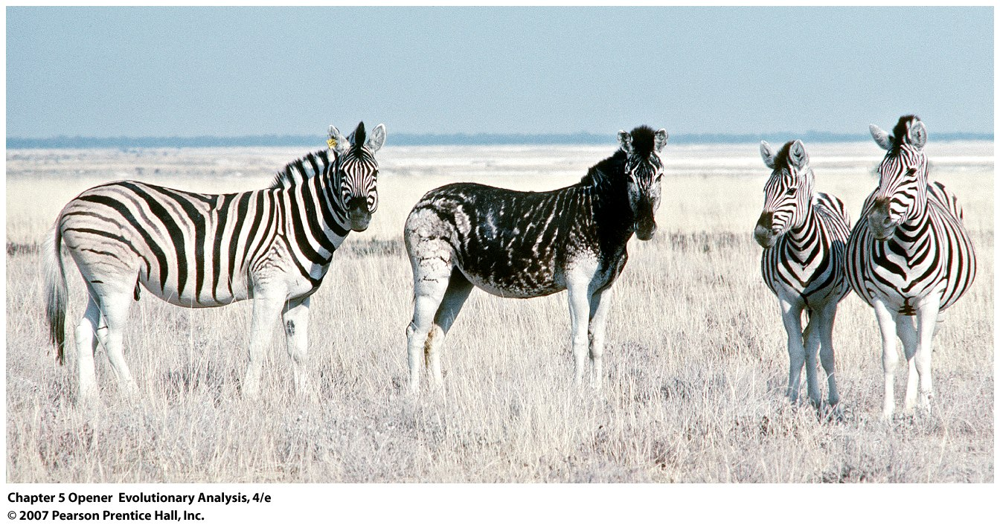

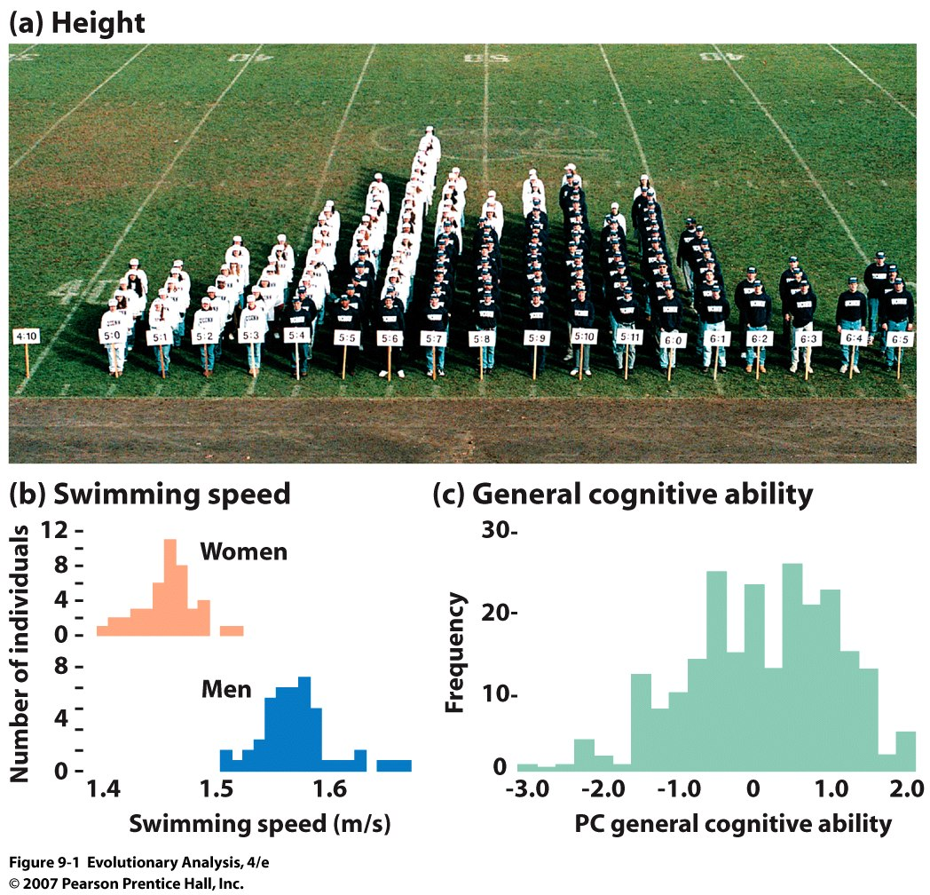
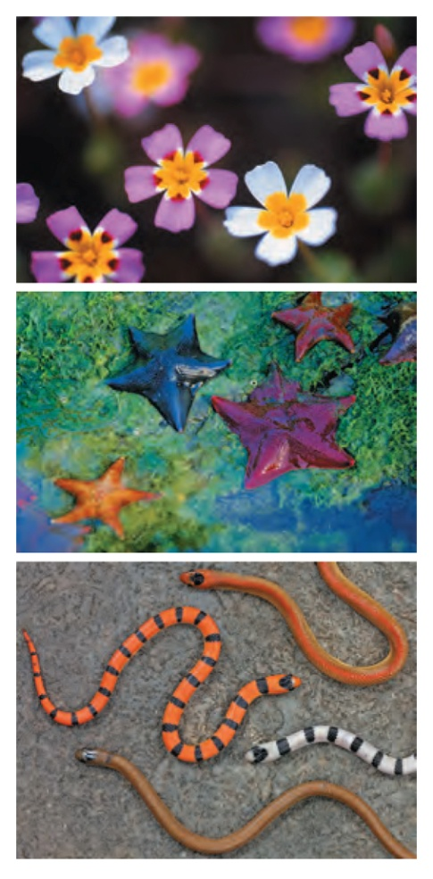
All populations demonstrate phenotypic variation, some of which is
due to genetic variation
Linantus ciliatus
Asterina miniata
Sonora seiminanulata
Notes:
Chapter 5 Opener
The zebra standing second from left is darkly colored or "melanistic," due to a mutation in a gene involved in the synthesis or transport of dark-colored melanin pigments.

Slide 3
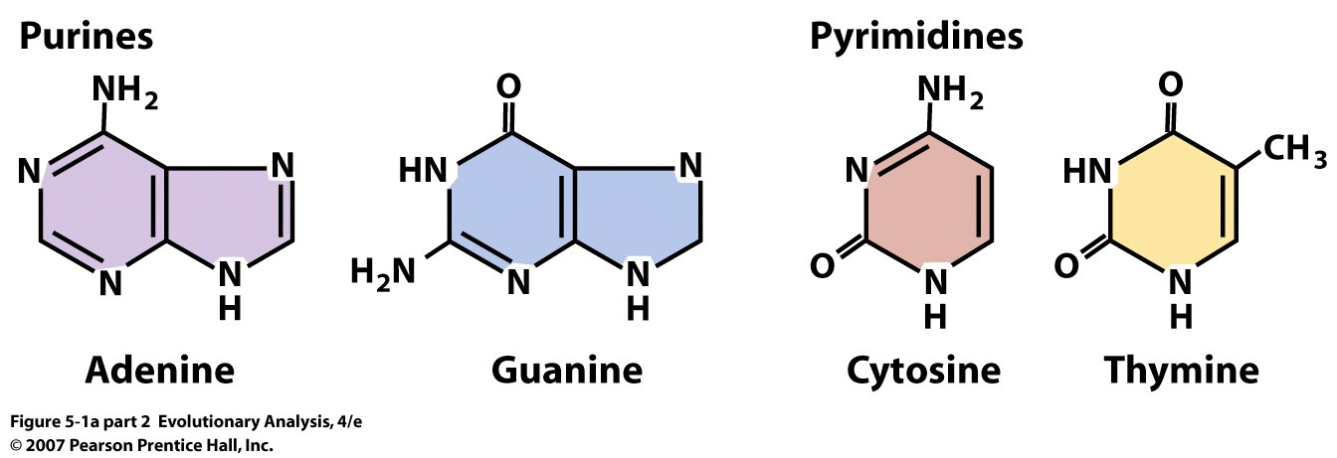
II. Origin genetic variation: What is a mutation???
-offspring has DNA that is different from both parents
-deleterious alleles in population are often referred to as mutations
Mutation = change in nucleotide, deletion, insertion, duplication,
inversion….
Notes:
Figure 5.1a (part 2) The structure of the genetic material
(a) The diagram on the left shows the generalized form of a nucleotide. Note that hydrogen and oxygen atoms bonded to the numbered carbons are not shown. The diagrams on the right show the structure of the four nitrogenous bases.

Slide 4
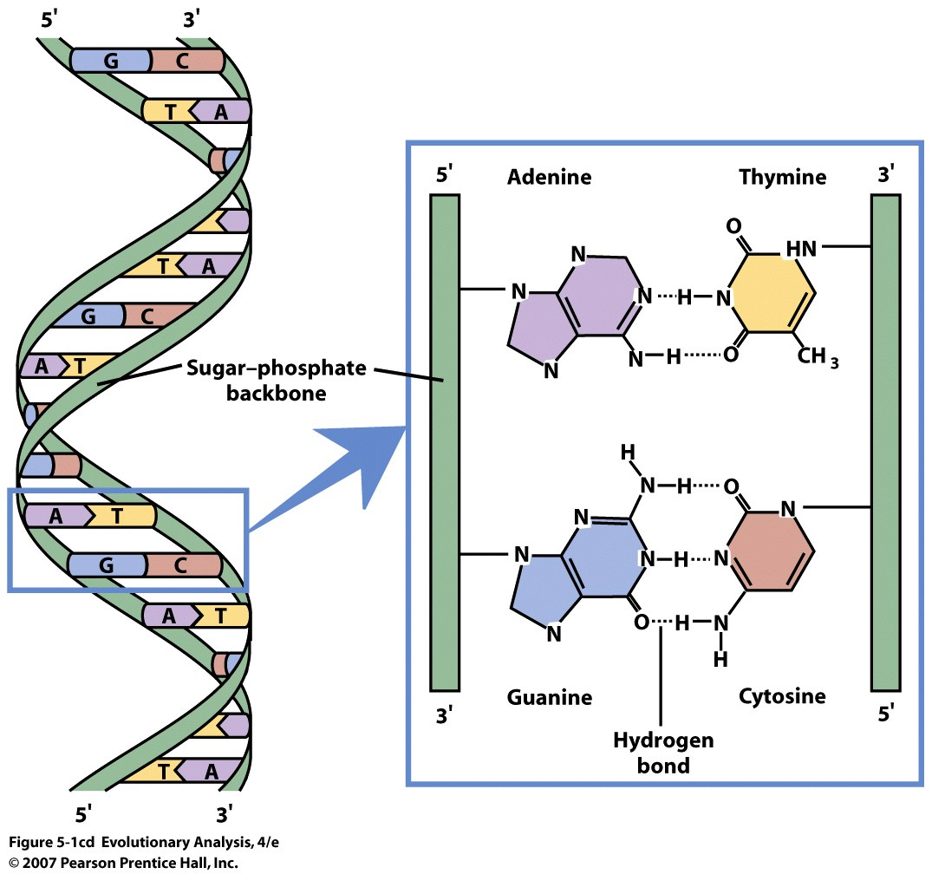
Notes:
Figure 5.1cd The structure of the genetic material
(c) When complementary bases on opposite DNA strands form hydrogen bonds, the molecule twists into a double helix like the one shown here. (d) Adenine and thymine form two hydrogen bonds; cytosine and guanine form three.

Slide 5
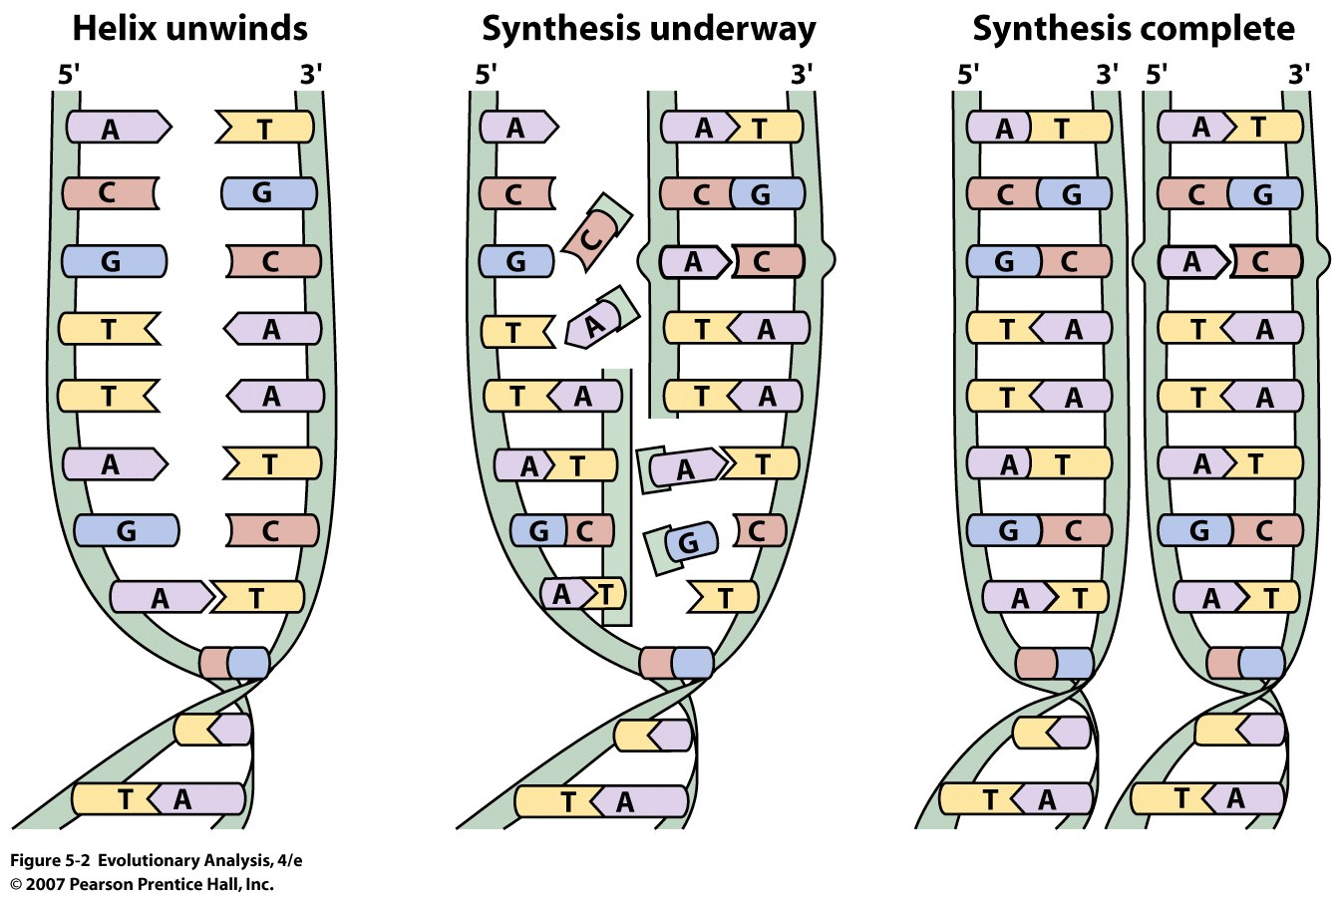
Notes:
Figure 5.2 DNA forms a template for its synthesis
Because of complementary base pairing, each strand in a DNA molecule forms a template for the synthesis of the complementary strand. If DNA polymerase inserts the wrong base, as in the strand at the far right, it results in a mismatched pair that must be repaired. If the repair is not made, a mutation results.
Primary determinant of fidelity:
Polymerase selectivity
Exonuceolytic proofreading
DNA mismatch repair MMR
Also during meoisis , crossing over

Slide 6
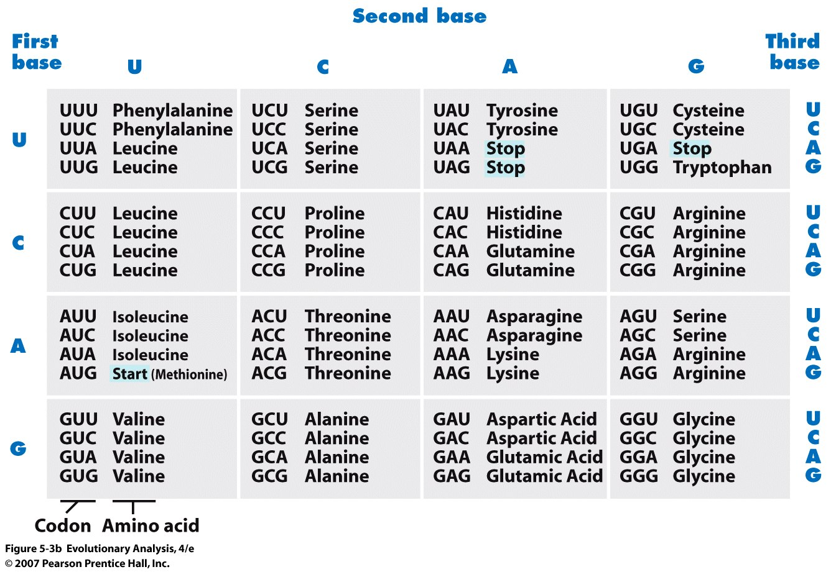
mRNA
Note: Genetic Redundancy of Code Results in Synonymous &
NonSynonymous Mutations for Protein Coding Regions
Notes:
Figure 5.3b In organisms, information flows from DNA to RNA to proteins
(b) This is the genetic code. Each of the 64 mRNA codons shown here specifies an amino acid or the start or end of a transcription unit. Note that in many instances, changing the third base in a codon does not change the message.
Note stop codons, note insertion effects

Slide 7
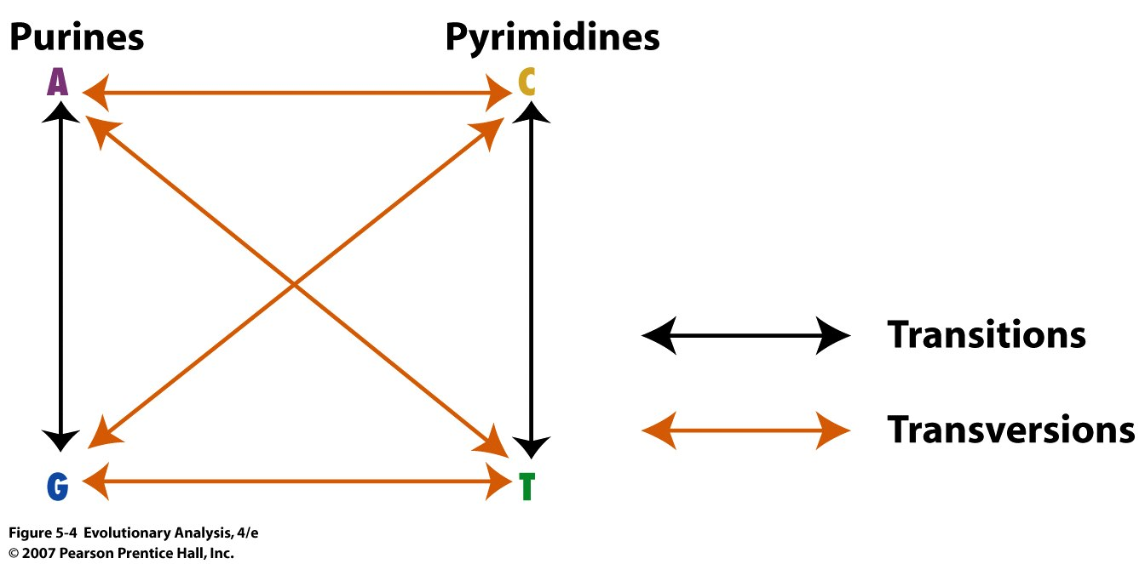
Transitions are more common than transversions because
DNA repair enzymes can recognize wrong insertion representing a
a transition better than a transversion
Notes:
Figure 5.4 Transitions and transversions

Slide 8
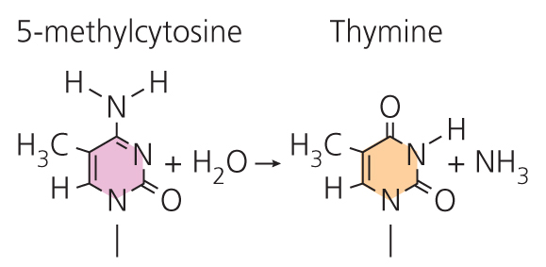
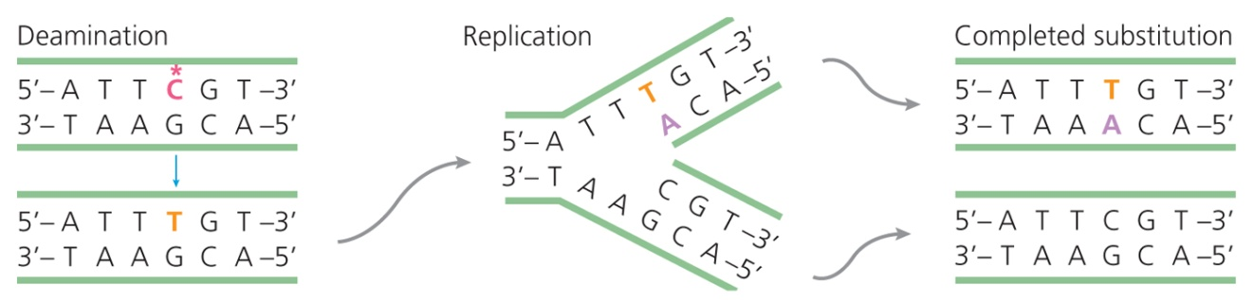
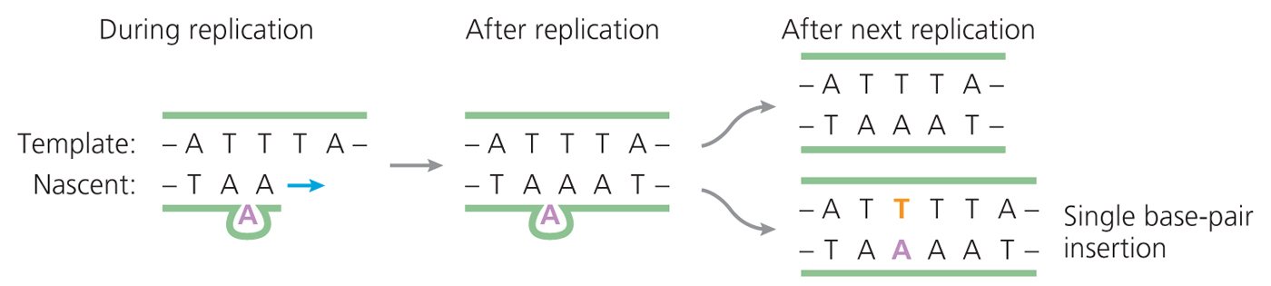
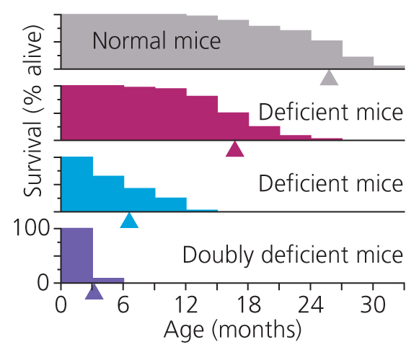
Common molecular mechanisms resulting in mutation

Slide 9
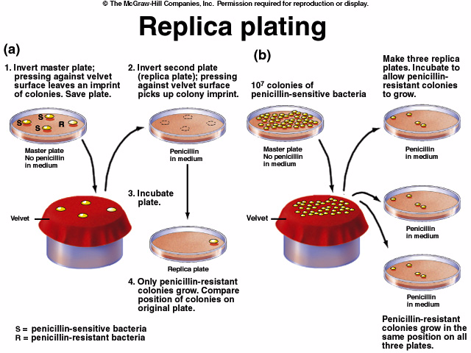
III. Properties of Mutations:
Random
Notes:
Somewhat, certain parts of the genome will generate more mutations than others

Slide 10
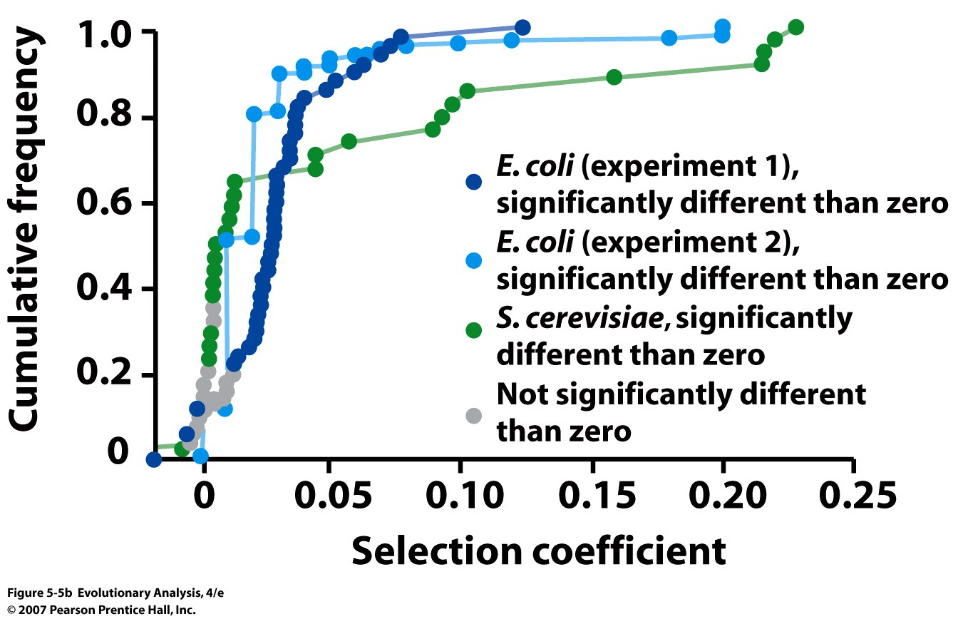
What are the effects of new (deletion) mutations? Deleterious? Strong?
s = 1 – fitness(mutation)/fitness(without mutation)
Fitness of genotype with mutation = 1 - s
Notes:
Figure 5.5 How do most mutations affect fitness?
(b) To create the data plotted here, researchers inserted DNA sequences into random locations in the genomes of Escherichia coli or the yeast Saccharomyces cerevisiae.
Strong or weak, depends, NeS

Slide 11
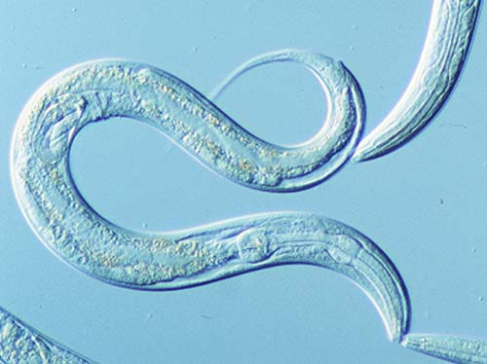
RATES: How do you measure mutation rates at the
DNA LEVEL?
Direct sequencing of C. elegans
Mutation Accumulation Lines
Denver et al. 2004
Generation 280: 29,561 bp in 72 MA lines
Generation 353: 14,550 bp in 68 MA lines
Generation 396: 18,718 bp in 58 MA lines
Detected: 30 mutations (17/30 indels)
Transitions >> Transversions 1.6:1
Mutation rate: 2.1 x 10⁻⁸ /site/generation
. . .
. . .
400 generations
= about 1 mutation/gamete or 2/zygote

Slide 12
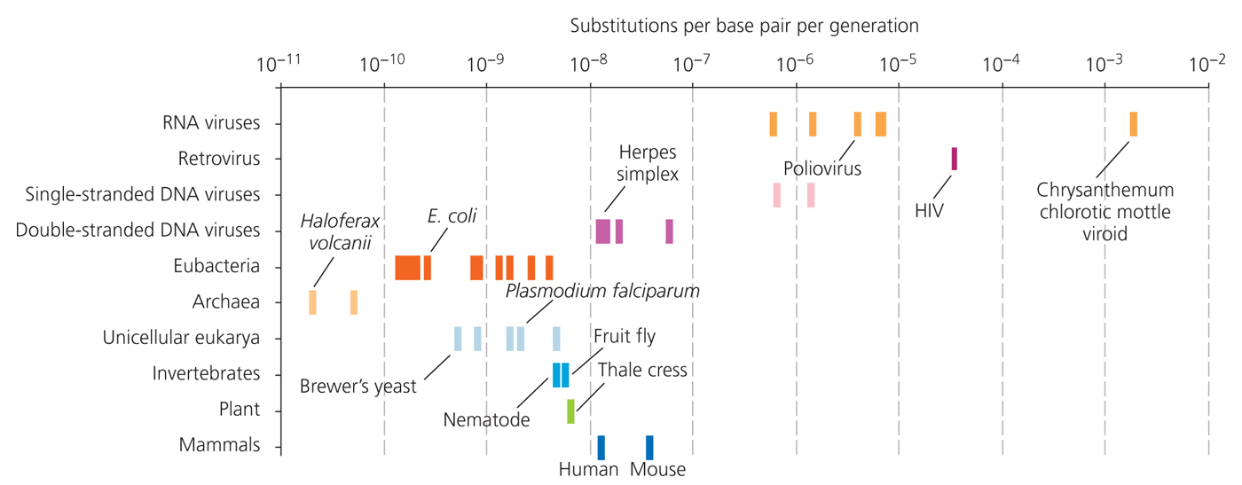
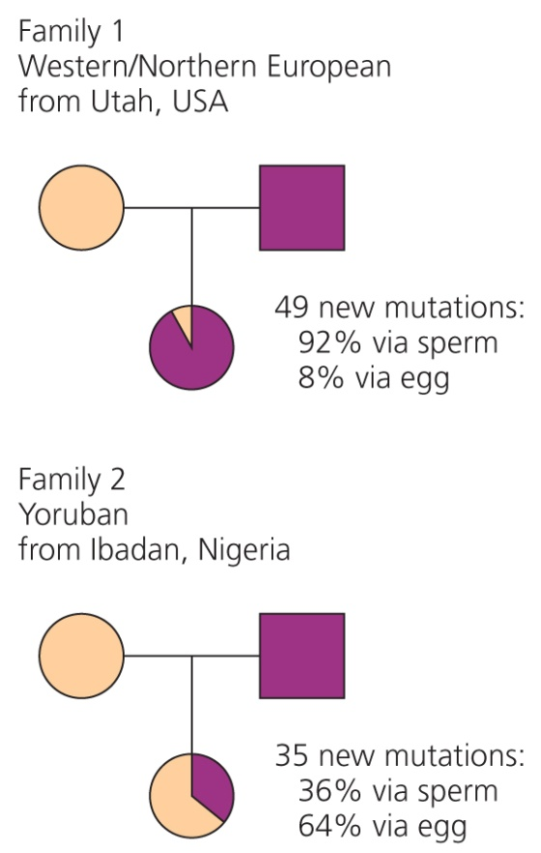
Figure 5-34
Mutation Rates Generally Low
And can evolve

Slide 13
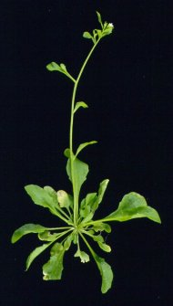

Mutation accumulation lines
Homozygous progenitor
Single
seed
descent
Mutation accumulation lines
Any genetic differences between lines = mutations
Notes:
Mukir was the first to employ a methodology that is still used today to study spontaneous mutations. The method employs what are termed mutation accumulation lines. A progenitor individual which has been selfed or inbred for many generations and is essentially homozygous at all loci is used to found a number of lines. Each of these lines is propagated by single seed descent, allowing even very deleterious mutations to drift to fixation. Over time, the lines begin to diverge from each other– the genetic divergence among the lines is due to spontaneous mutations ocurring within the lines. We can use the rate at which the lines diverge to esimate the number of mutations that occur each generation affecting a measured trait, and we can use the trait values in the lines relative to the progenitor individual (or proxies thereof) to understand the effects of mutation.

Slide 14
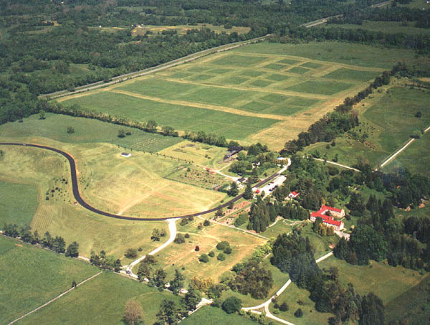
Current project: extending MA research to field studies
Notes:
We planted at Blandy

Slide 15
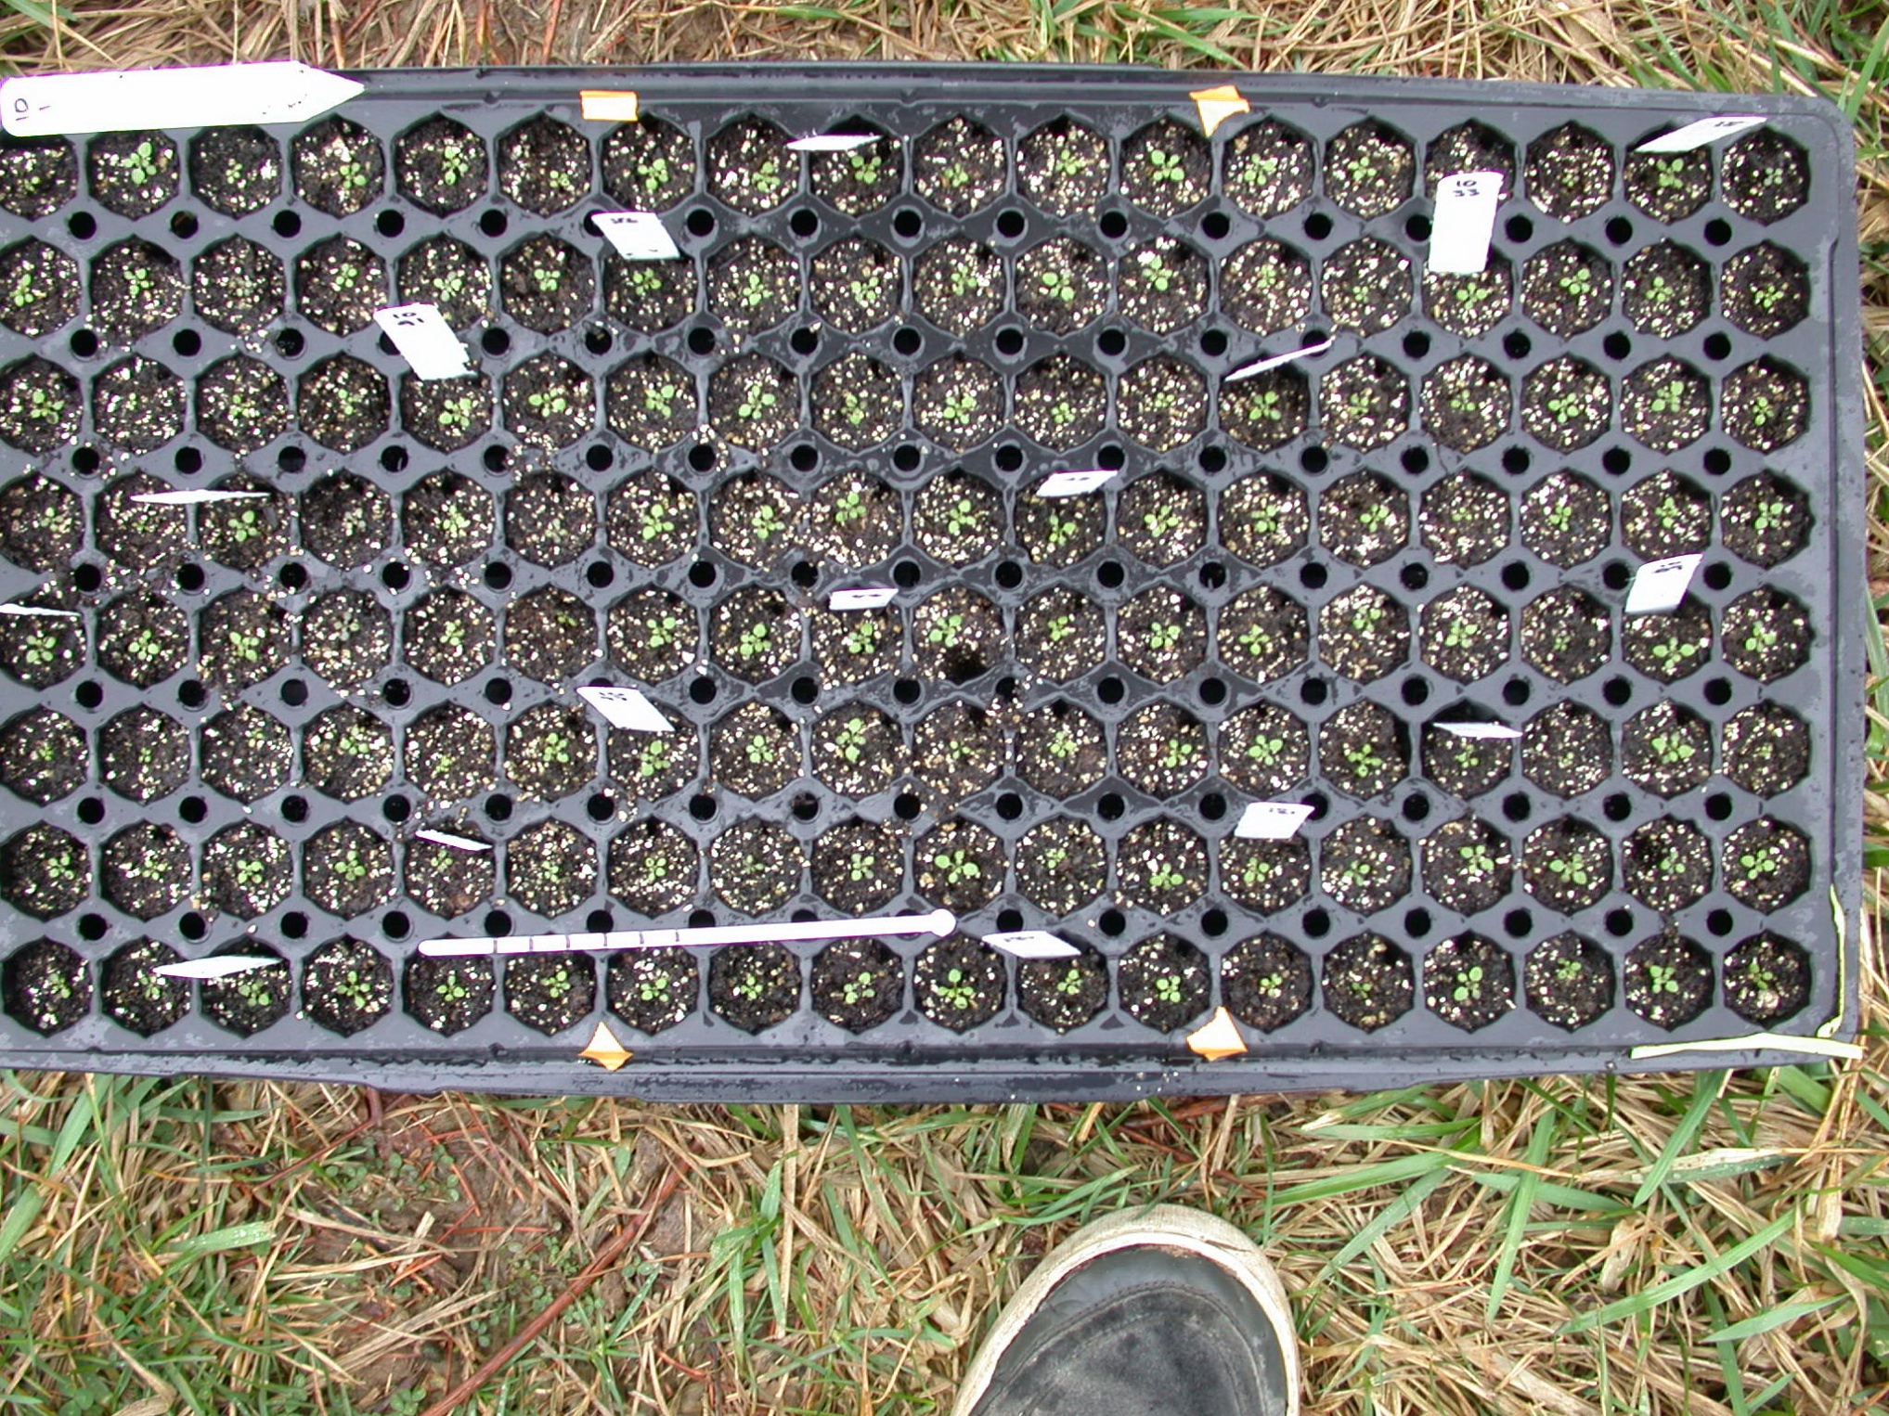
planted at 4 leaf rosette stage
Notes:
For most of our experiments, we actually grew the plants for about 2 weeks in the greenhouse and transplanted them into the field as seedlings. We took digital images of the plants at this transplant stage, to see if we could detect an effect of mutation on early size. We worked with a team of undergraduate students in the lab that I trained on analyzing the image data to take morphometric data.

Slide 16
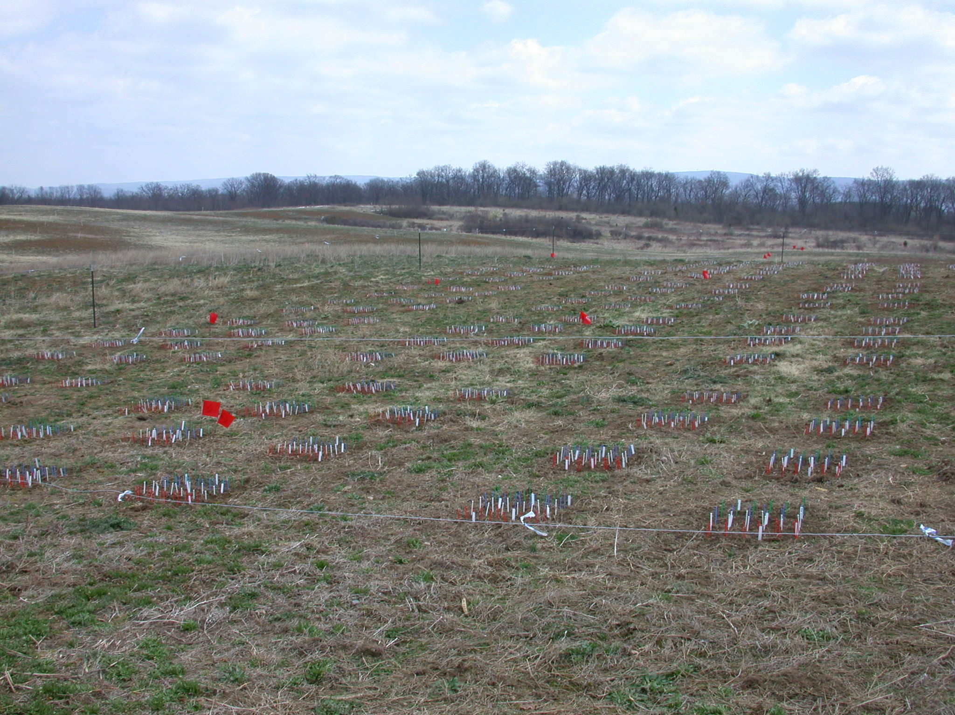
Field Site After Planting
100 lines(25th generation of MA) x 70 Replicates/line =
7000 + 500 parentals (founders) = 7500 plants
Notes:
So in each one of our experiments we planted about 7500 plants.

Slide 17
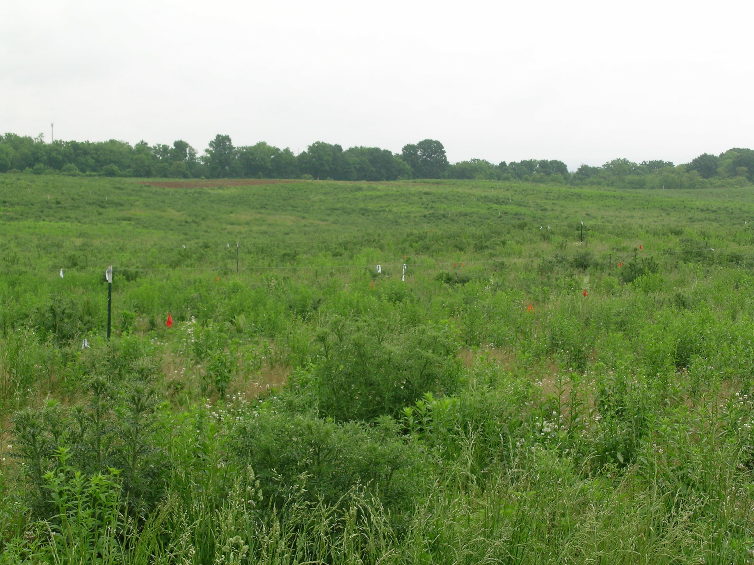
Site 8 weeks later at harvest
Notes:
As you can see, when we harvested the plants 8 weeks later the site looked remarkably different. Again, not quite the same thing as what happens in the greenhouse.

Slide 18
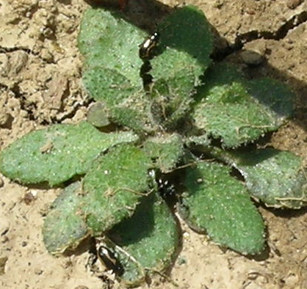
Herbivory
Notes:
Plants did experience things they hopefully don’t in the greenhouse, such as flea beetle herbivory.

Slide 19
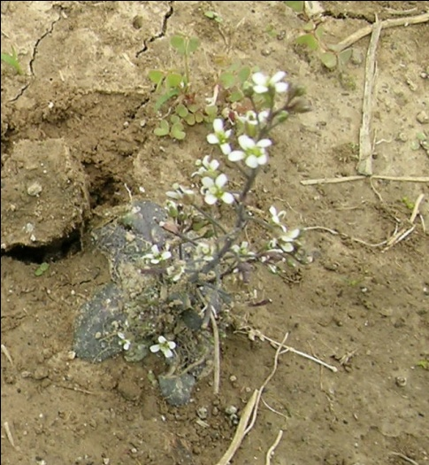
MA lines have diverged in fitness
Founder performance is near the average MA performance
Block <0.0001
MA line 0.029 MA line vs. Founder 0.8650
Subline 0.0051
Notes:
Here’s the big one fitness as measured as a combination of survival and fruit number. Yep it is in the middle.

Slide 20
The Rate and Molecular Spectrum of Spontaneous Mutations in Arabidopsis thaliana, Ossowski et al., 2010, Science, 1 January
Conducted 30 generations of MA
Screened 5 MA lines (we tested for performance)
Detected 114 mutations
Mutation Rate:
30 x 5 = 150 episodes
111 mutations/150
~ 1.4 mutations per diploid or zygote generation
Each line ~ 20 mutations
Accuracy: about 1 new mutation for every 200 mbp replicated

Slide 21
Mutations Detected
Dark blue lines are mutations in coding
regions
Notes:
Fig. 1. Distribution of spontaneous mutations across chromosomes. Labels indicate the
type of mutation and colors their functional context or predicted effect. Short insertions
and deletions are shown by the letters representing the affected bases preceded by a plus
or aminus sign, respectively. Long deletions are depicted by aminus sign and the number
of deleted base pairs in parentheses. An asterisk next to a C or a G means that the cytosine
of the mutant base pair is known to be methylated (20). The definitions for colors are as follows: red, intergenic
region; yellow, intron; dark blue, nonsynonymous substitution, shift of reading frame for short indels, or gene
deletion for large deletions; green, synonymous substitution; purple, UTR; and light blue, transposable element.
UTR equals untranslated just upstream and downstream region, transcribed but not translated, can be associated with efficiency of translation and stability of the mRNA

Slide 22
Comparison of Mutation Rate at Sequence Level vs. Performance
For each new zygote:
1.4 mutations at the sequence level
0.24 mutation rate for performance
About 20% of mutations effect performance
About 80% of mutations have no effect on performance
About 20% of all sequence mutations were nonsynonymous
and in coding regions
Rutter et al., Evolution, 2012

Slide 23
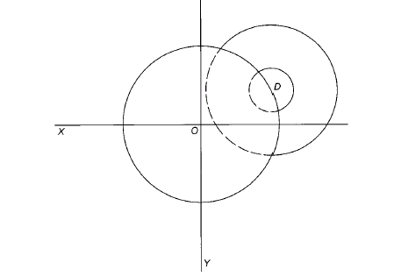
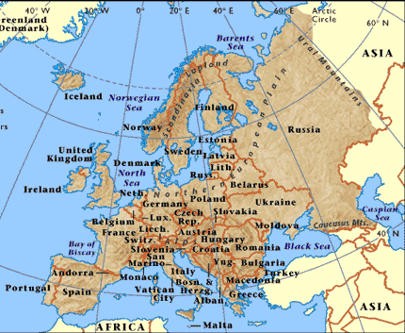
Adaptive landscapes & mutation parameters
New MA lines from
Sweden and France
Fisher, 1930
Beginning of a conceptual framework for the prediction of mutation effects
(with Jon Agren, Thomas Lenormand, Eric Imbert, Detlef Weigel &Stephen Wright)
Notes:
With Thomas Lenormand pierre Olivier Cheptou and Eric Imbert, work of Lenormand and Martin, variance of mutation effects increases with stress etc

Slide 24
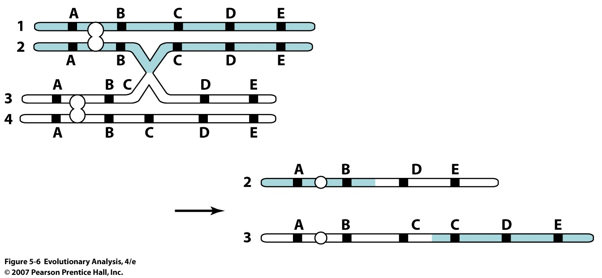
IV. Origin of new loci/function: Gene Duplication
Notes:
Figure 5.6 Unequal cross-over and the origin of gene duplications
The letters and bars on each chromosome in the diagram indicate the location of genes; the open circles indicate the location of the centromere. The chromosomes on the left have synapsed, but cross-over has occurred at nonhomologous points. As a result, one of the cross-over products (chromosome #2) lacks gene C and one (chromosome #3) has a duplication of gene C.

Slide 25
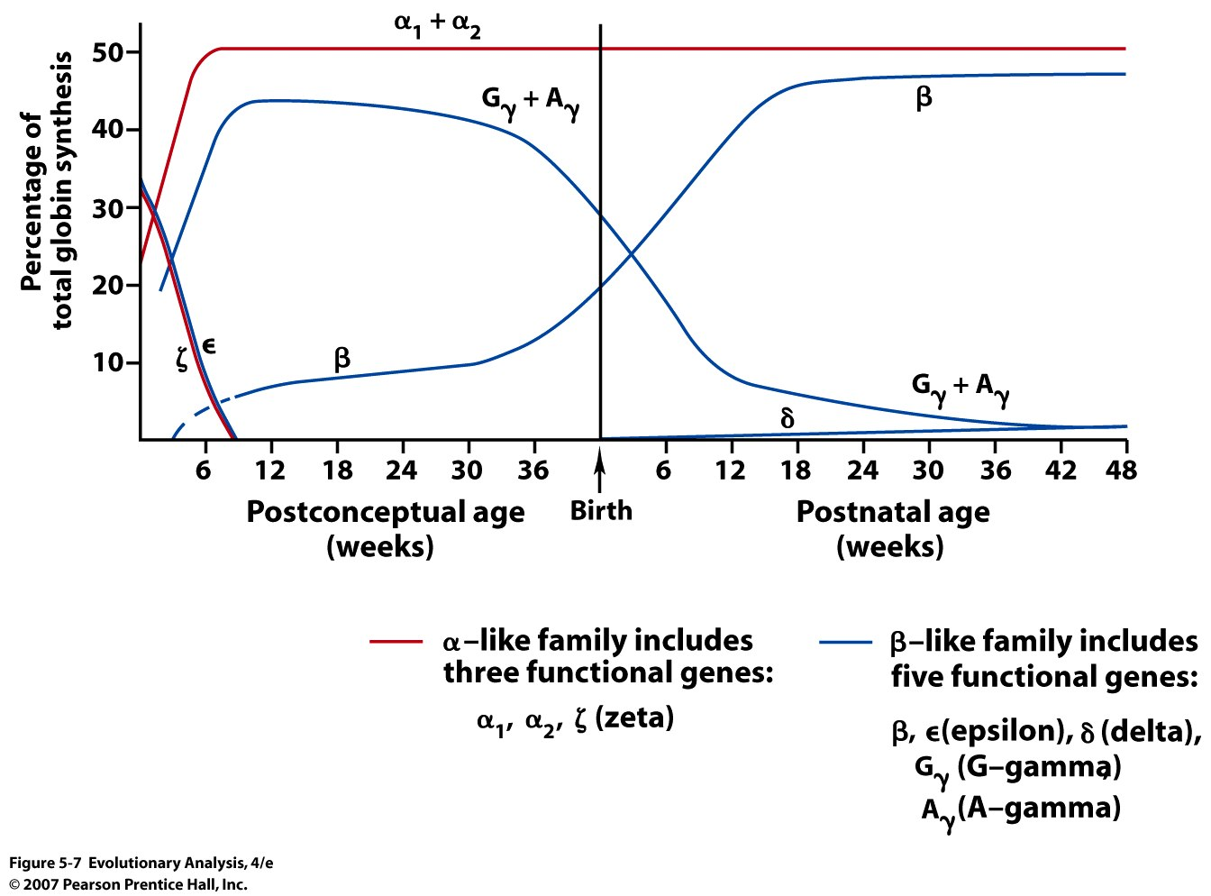
Timing of expression differs among members of the globin gene families
Notes:
Figure 5.7 Timing of expression differs among members of the globin gene families
This graph shows changes in the expression of genes from the α- and β-globin families in humans during pregnancy and after birth. In embryos, hemoglobin is made up of ζ-globin from the α-like gene cluster and ε-globin from the β-like gene cluster. In the fetus, hemoglobin is made up of α-globin from the α-like gene cluster and γ-globin from the β-like gene cluster. In adults, most hemoglobin is made up of α-globin from the α-like gene cluster and β-globin from the β-like gene cluster; a small number contain δ-globin. Each of these hemoglobins has important functional differences.
Discuss Adaptive signfivicance
Over the course of vertebrate evolution, subsequent rounds of gene duplication and divergence have given rise to families of α- and β-like globin genes that are ontogenetically regulated and biochemically optimized for oxygen transport under the vastly different physiological conditions that are encountered during the embryonic, fetal, and adult stages of development. The globin superfamily of genes therefore provides an excellent example of how physiological pathways can be elaborated and refined through functional and regulatory divergence of duplicated genes that encode different subunit polypeptides of the same multimeric protein.

Slide 26
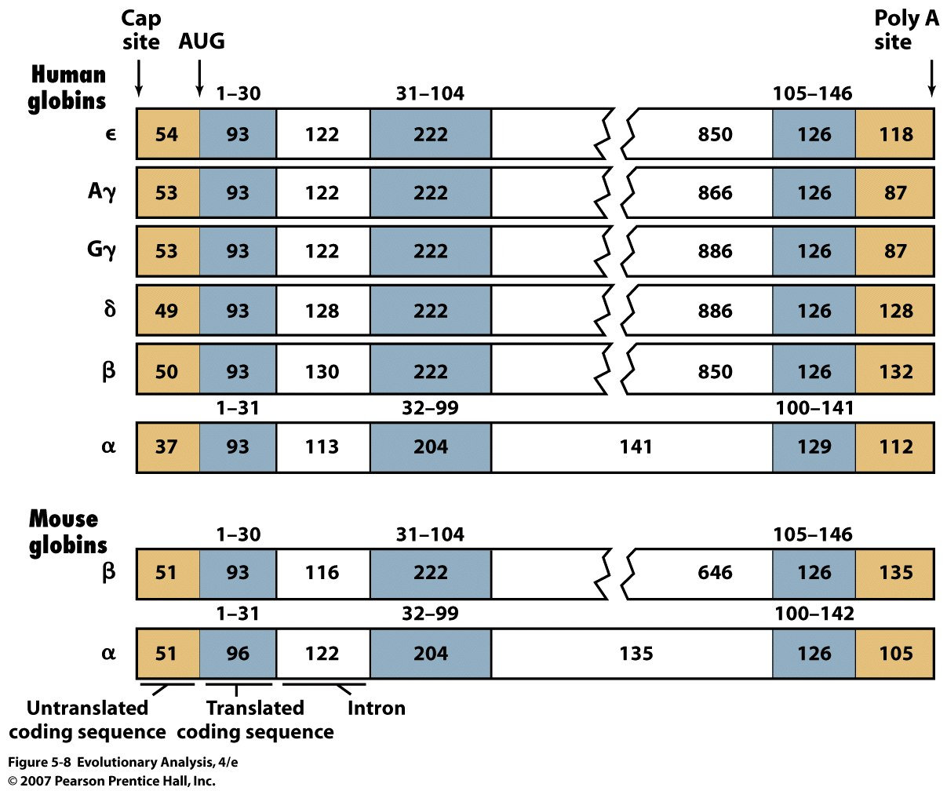
Homologous genes come in one of two types:
O
P
Paralogs- loci that diverge following duplication
Orthologs- loci that are homologous then diverge following speciation
Pseudogenes- class of genes that have no function (non-transcribed)
Notes:
Figure 5.8 Transcription units in the globin gene family. All evidence is consistent with duplication.
In these diagrams, the numbers inside the boxes denote the number of nucleotides present in the primary transcript, while the numbers above the boxes give the amino acid positions in the resulting polypeptide. AUG is the start codon. The lengths and positions of introns and exons in loci throughout the α- and β-like clusters are virtually identical.
Orthologs diverge after speciation, paralogs diverge after duplication.

Slide 27
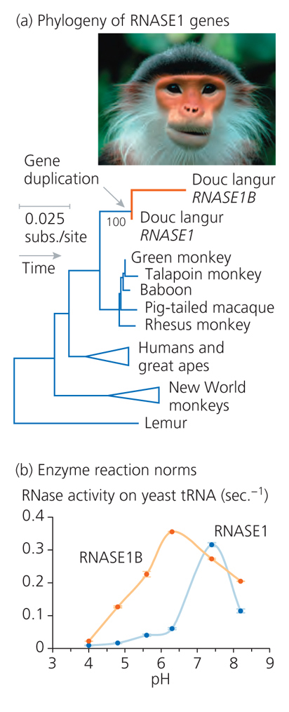
Notes:
Southeast Asian monkey eats a lot of leaves, RNSase releases N in RNA of leaves

Slide 28
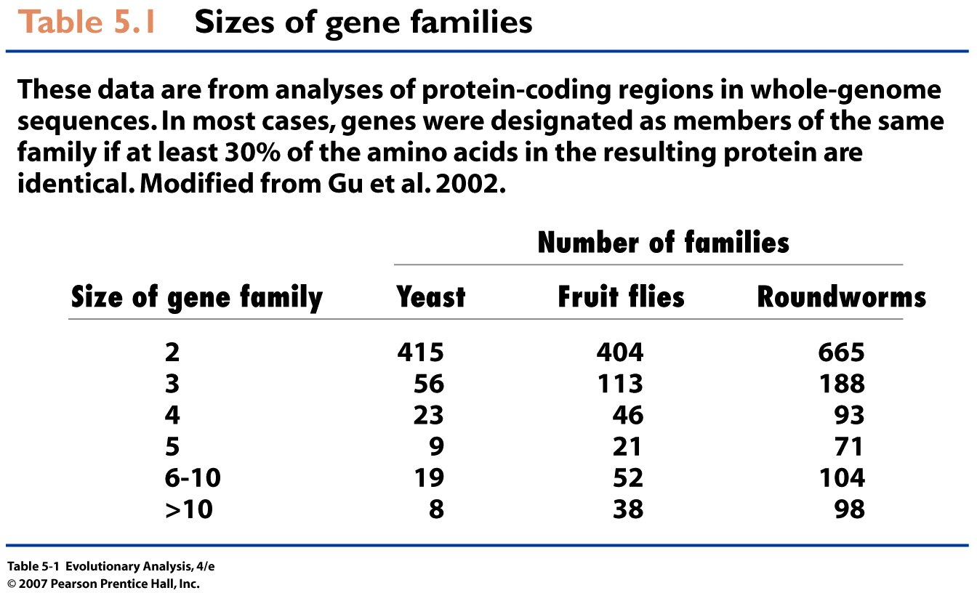
Importance of gene duplication to evolution? VERY
Notes:
Table 5.1 Sizes of gene families

Slide 29
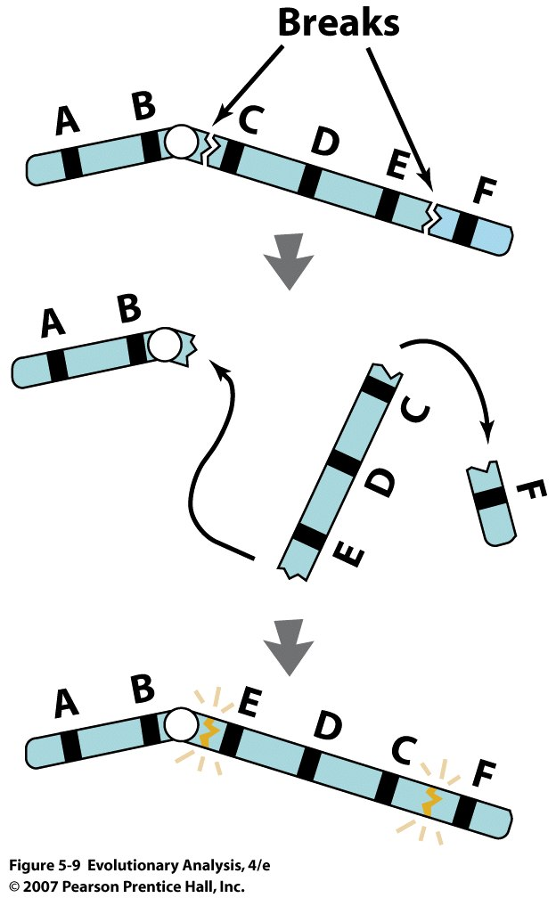
V. Chromosome Inversions
Suppress recombination
Notes:
Figure 5.9 Chromosome inversion
Inversions result when a chromosome segment breaks in two places, flips, and reanneals. Note that after the event, the order of the genes labeled C, D, and E is inverted.

Slide 30
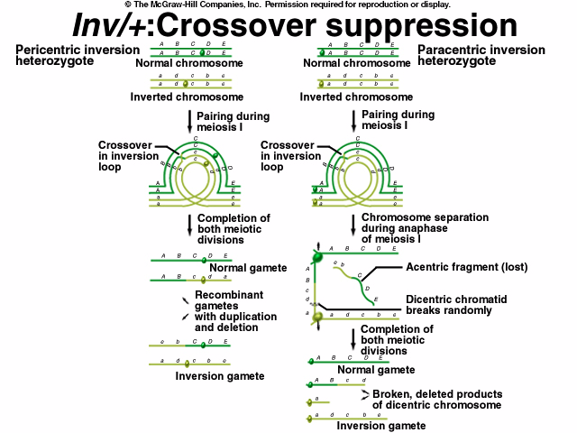
inversions
can keep
gene
combinations
intact, eg.
A/abcdE/e
AND THE EVOLUTIONARY IMPORTANCE?????????
Notes:
Double cross over
Gene conversion

Slide 31
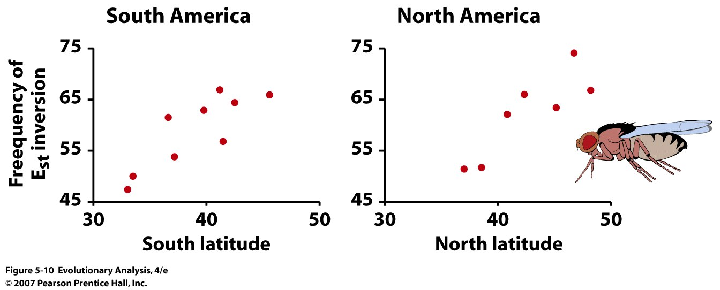
Evidence that inversions are associated with adaptation
in Drosophila subobscura
ALSO LINKAGE DISEQUILIBRIUM WITHIN INVERSION
Notes:
Figure 5.10 Inversion frequencies form clines in Drosophila subobscura
These graphs plot the frequency of an inversion called E_{st} in South American and North American populations of Drosophila subobscura. From data in Prevosti et al. 1988; see also Balanya et al. 2003.

Slide 32
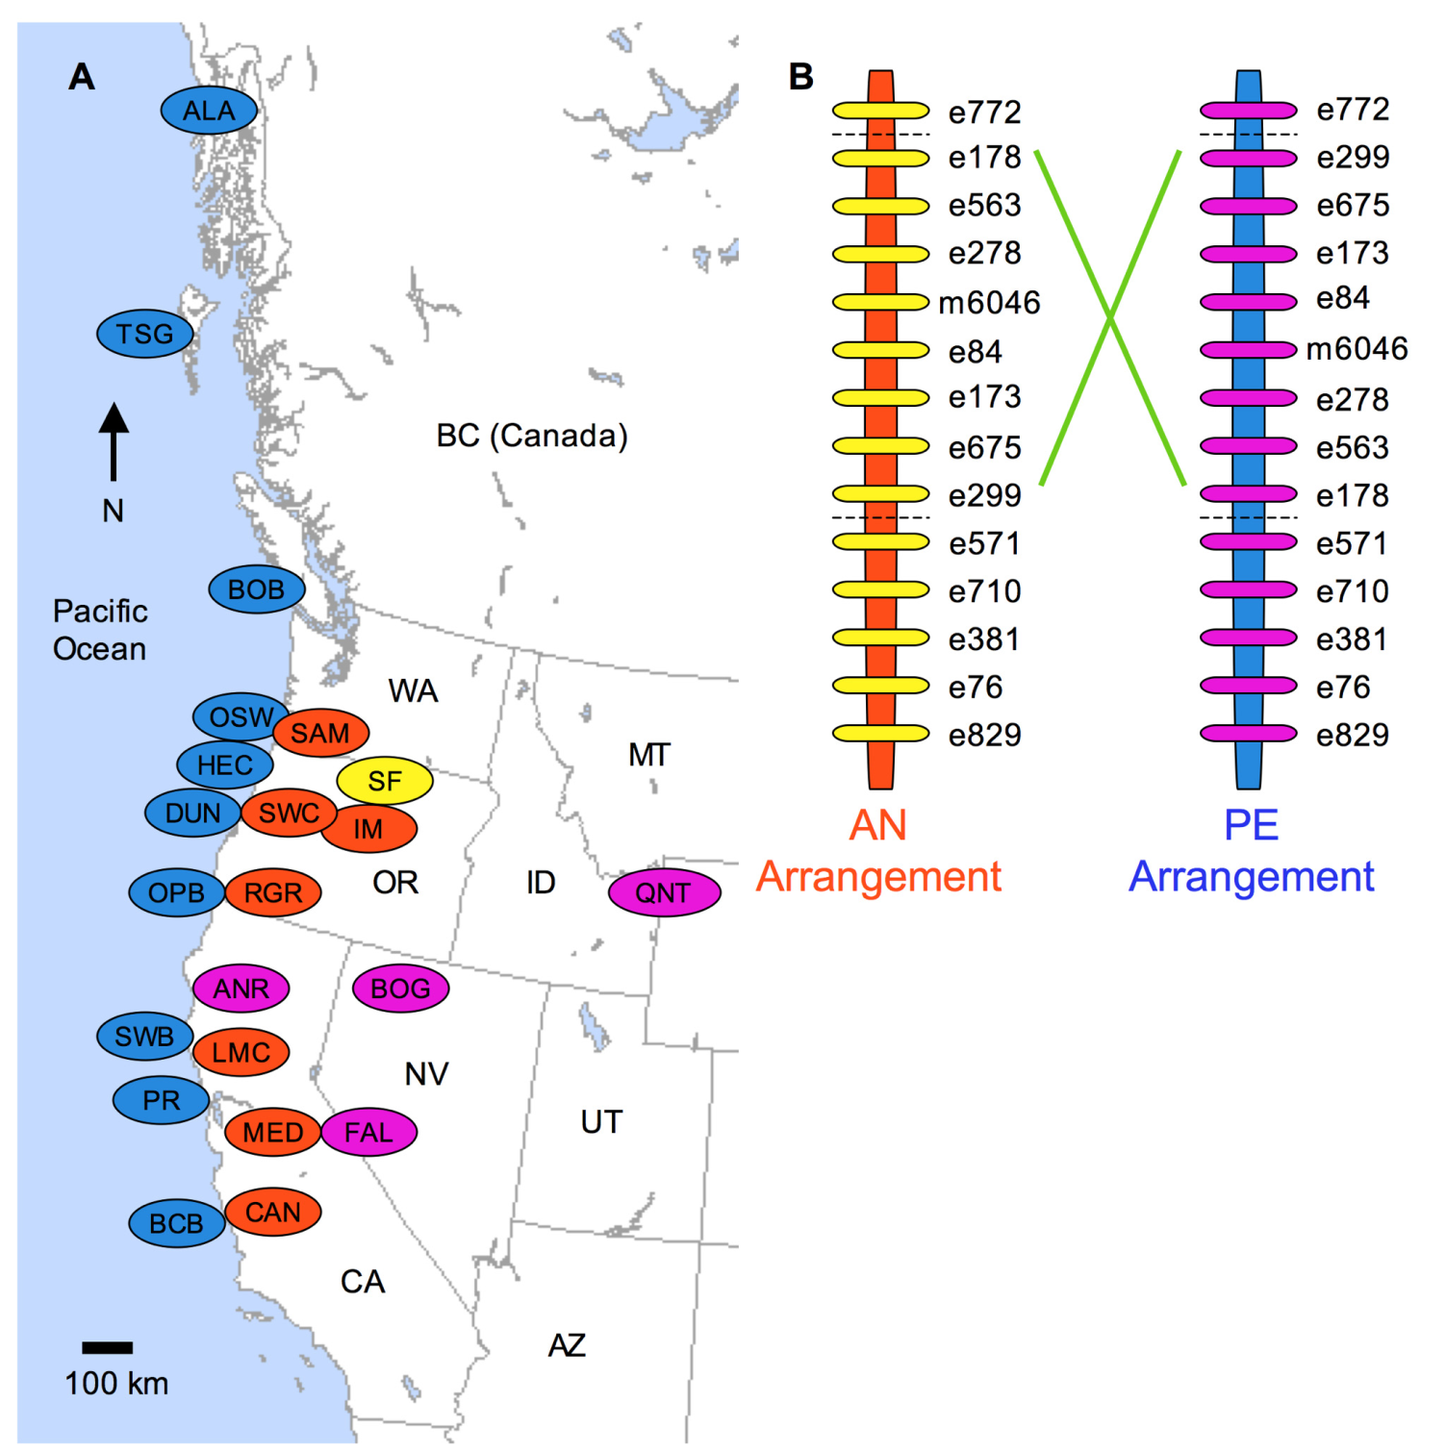
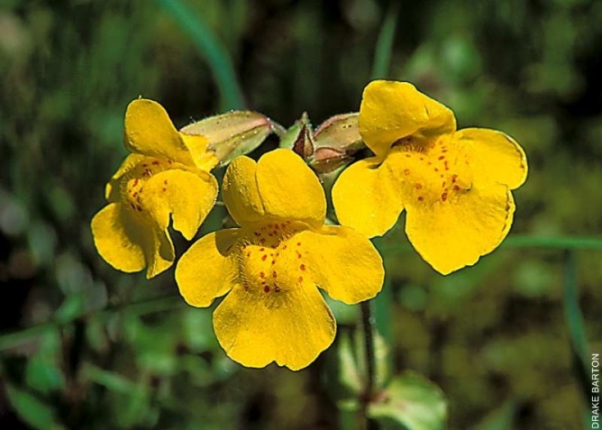
Mimulus guttatus
Figure 1. Geographic distribution of the chromosomal inversion. (A) Map of western North America with the locations of populations ofcoastal perennials (blue), inland annuals (orange), and inland perennials (purple), as well as obligate self-fertilizing species M. nasutus (yellow). (B) Marker order of the AN and PE inversion arrangements along linkage group eight. Inland annuals and M. nasutus had the AN arrangement whilecoastal and inland perennials all had the PE arrangement.
doi:10.1371/journal.pbio.1000500.g001
Adaptive Inversion Contributes to Isolation
PLoS Biology | www.plosbiology.org 3 September 2010 | Volume 8 | Issue 9 | e1000500

Slide 33
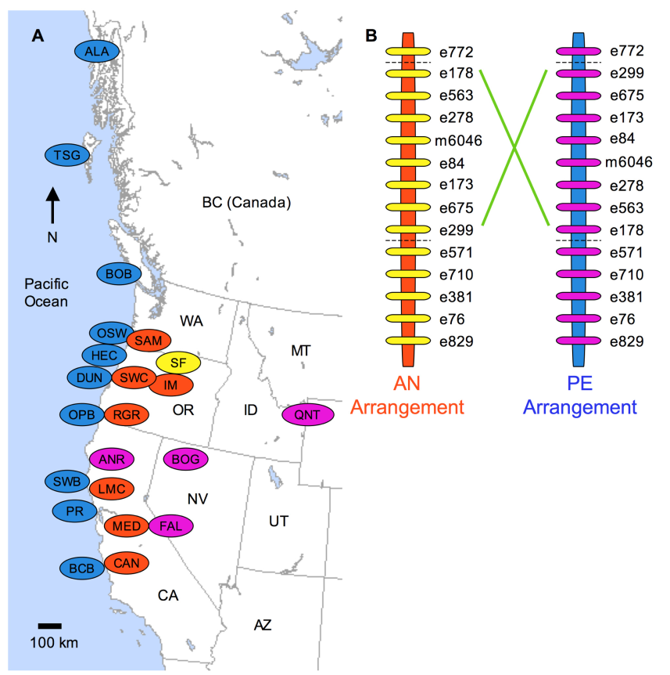
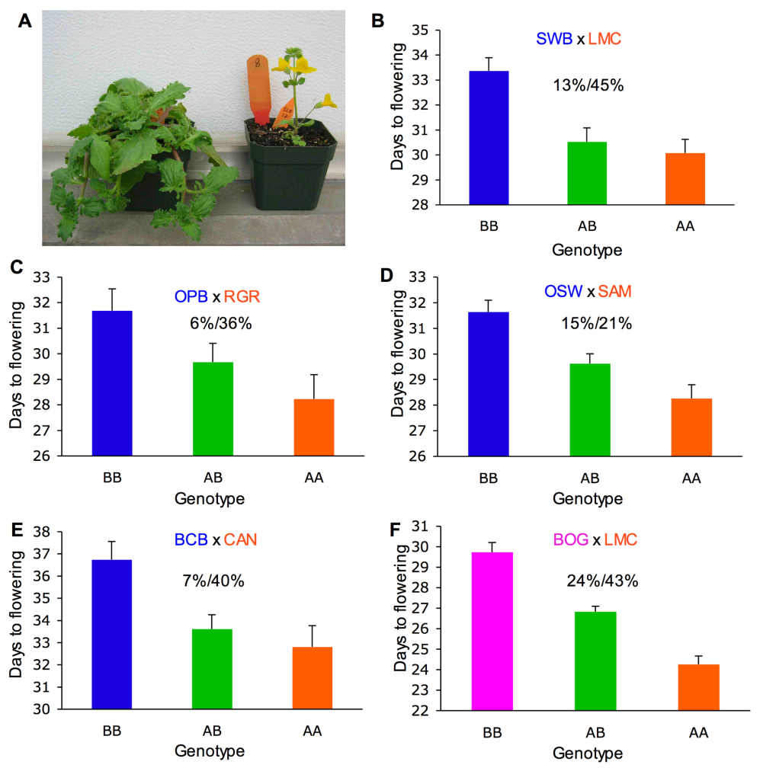
Figure 2. Replicated effect of the inversion locus. (A) F2 progeny with parental ecotypic phenotypes, from a cross between the SWB (coastal
perennial) and LMC (inland annual) populations. (B–E) Effect of the inversion on flowering time in four independently derived F2 mapping
populations created through crosses between independent inland annual and coastal perennial populations. (F) Effects of the inversion on flowering
time in cross between inland annual and inland perennial populations. The mean flowering times (61 SE) of F2s that were homozygous for the AN
arrangement (AA), heterozygous (AB), and homozygous for the PE arrangement (BB) at Micro6046 are indicated. The percentage of F2 variance/
parental divergence explained by the inversion is presented above each bar graph. Note: y-axes do not originate at zero.
doi:10.1371/journal.pbio.1000500.g002

Slide 34
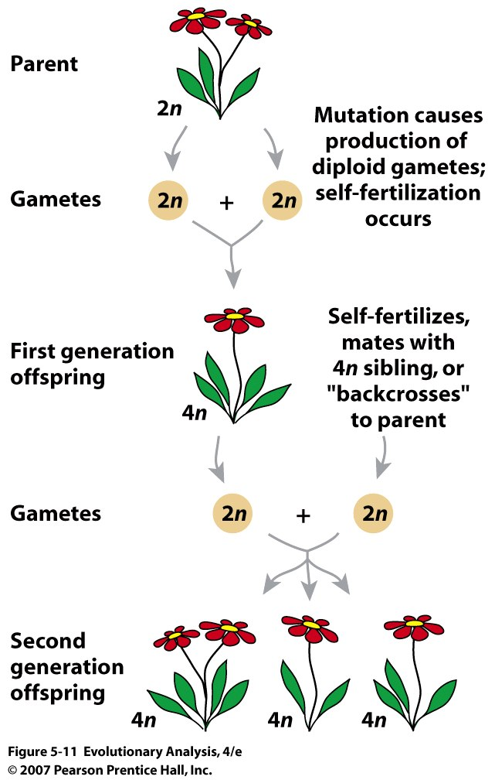
VI. Polyploidy
duplication of
the basic number
of chromosomes,
e.g.: 2n to 3 n to
4n etc.,
Results in instant
speciation
Common, in plants Why?
Answ: meiosis exposed, sex chromo. rare, selfing frequent.
Notes:
Figure 5.11 How are tetraploid individuals produced in plants? Plants can self, and do not have sex chromosomes.
See text for explanation.

Slide 35
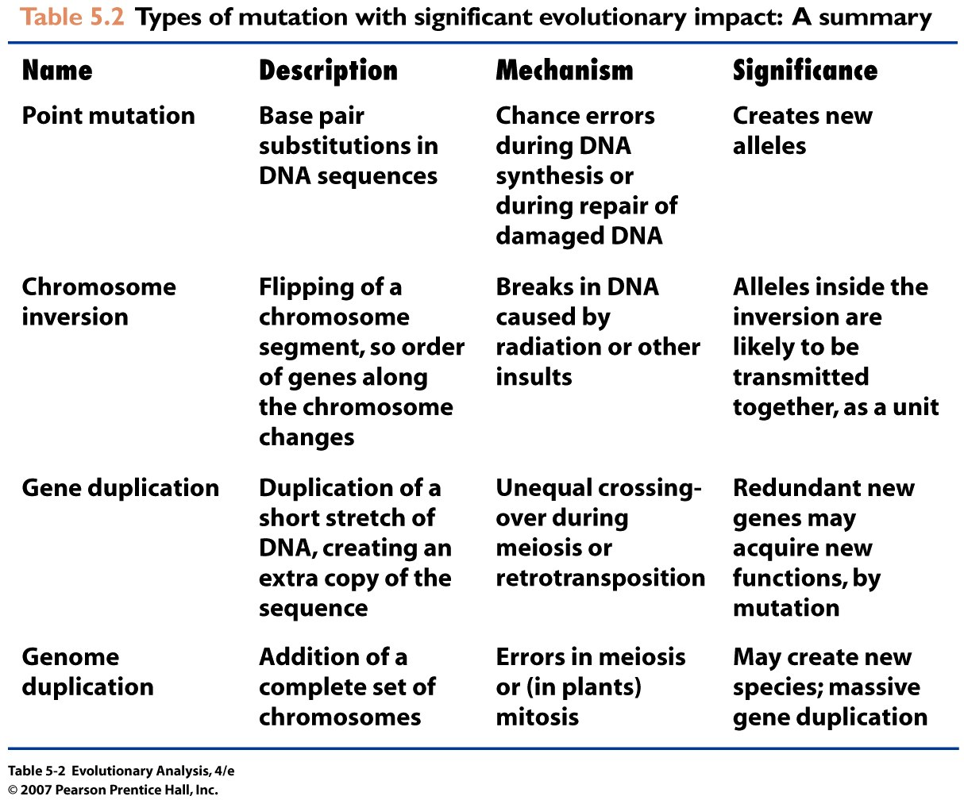
And others: Translocation, transposable elements…
Notes:
Table 5.2 Types of mutation with significant evolutionary impact: A summary

Slide 36
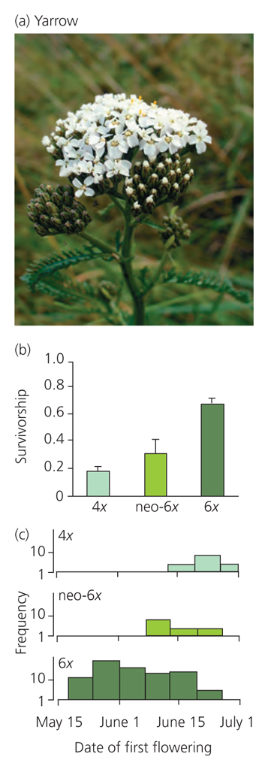
Gene Duplication and Adaptation:
Variation, Survivorship in a common garden in dunes and flowering time distributions of yarrow with different ploidy

Slide 37
VII. Much variation in populations
Heterozygosity: average frequency of heterozygotes across loci
Proportion of loci polymorphic

Slide 38
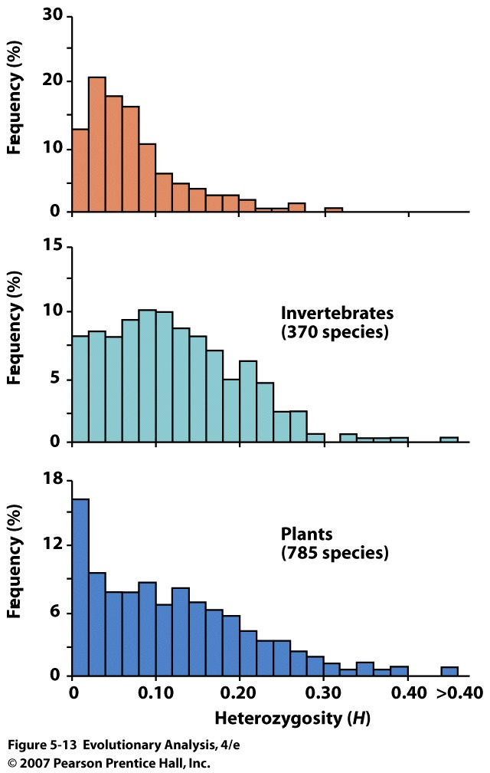
The distribution of enzyme heterozygosities among species
of animals and plants
Vertebrates
Fraction of loci that are heterozygous in the genotype of the average individual
Notes:
Figure 5.13 Analysis of proteins reveals that most populations harbor considerable genetic diversity
These histograms show the distribution of enzyme heterozygosities among species of animals and plants. For example, about 7% of all plant species have a heterozygosity between 0.10 and 0.12. From Fig. 2.2, p. 19, of Avise (1994). © 1994, Chapman and Hall. Reprinted by permission of Kluwer Academic Publishers.

Slide 39
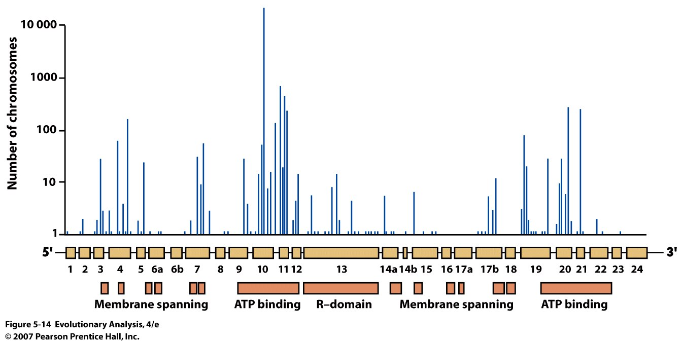
Sequencing studies have revealed enormous genetic diversity at
the cystic fibrosis locus in humans.
Loss of function mutations found in humans with cystic fibrosis
Notes:
Much more variation detected at the DNA level.
Figure 5.14 Sequencing studies have revealed enormous genetic diversity at the cystic fibrosis locus in humans
This graph shows the abundance and location of the loss-of-function mutations discovered in an analysis of over 30,000 disease-causing alleles at the cystic fibrosis locus. The histogram shows the number of copies of each mutation found. The genetic map below it, in which the boxes represent exons, shows the location of each mutation within the CFTR gene. The boxes at the bottom of the graph give the functions of the coding regions of the gene. From Fig. 2, p. 395, in Tsui (1992). Copyright © 1992, Elsevier Science. Reprinted with permission of Elsevier Science.

Slide 40
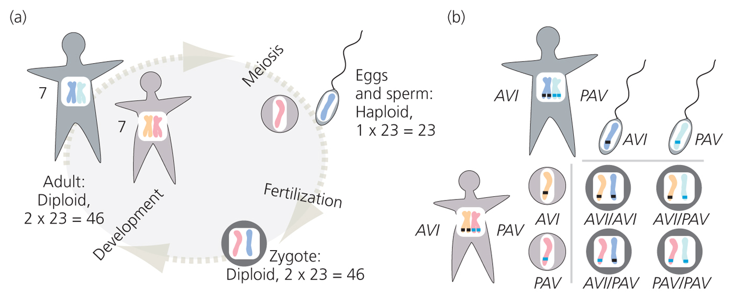
Figure 5-7
Offspring of two Heterozygotes for TAS2R38, PAV and AVI alleles
*AVI/AVI individuals cannot taste bitter taste of broccolli = vegetarians
http://www.nature.com/nature/journal/v486/n7403_supp/full/486S16a.html

Slide 41
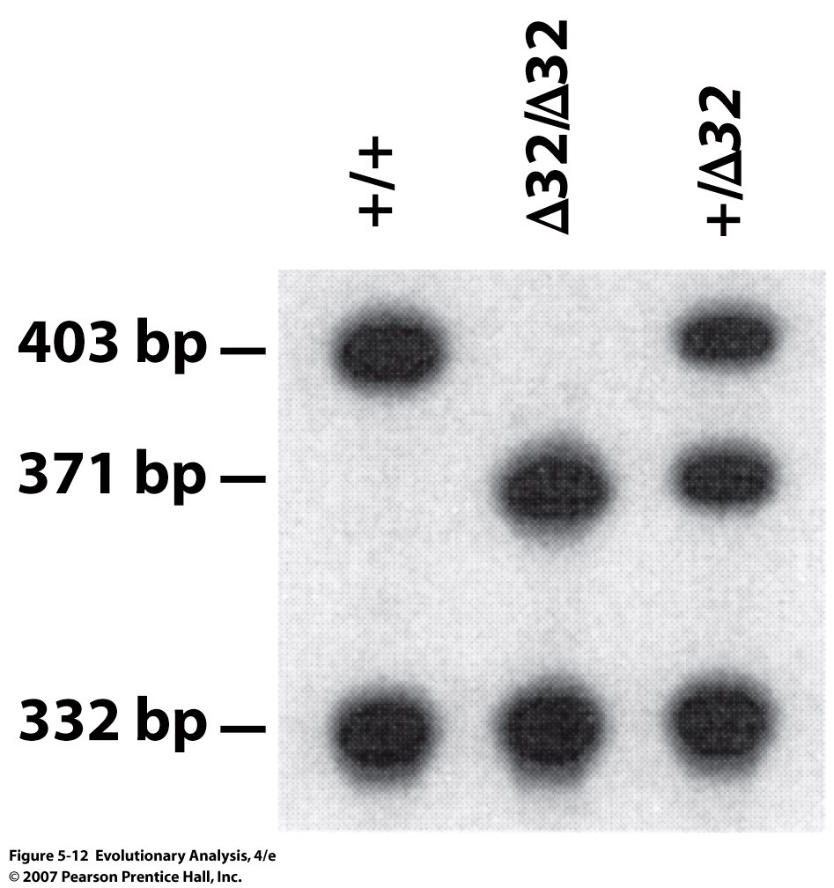
Determining CCR5 genotypes by electrophoresis of DNA
Calculating Heterozygosity:
Origin of fragment size: shorter by 32 nuc.
Notes:
Figure 5.12 Determining CCR5 genotypes by electrophoresis of DNA
Each lane of this gel contains DNA fragments prepared from the CCR5 alleles of a single individual. The locations of the dark spots, or bands, on the gel indicate the sizes of the fragments. Each genotype yields a unique pattern of bands. From Samson et al. (1996). Reprinted with permission from Nature. © 1996, Macmillan Magazines Ltd.

Slide 42
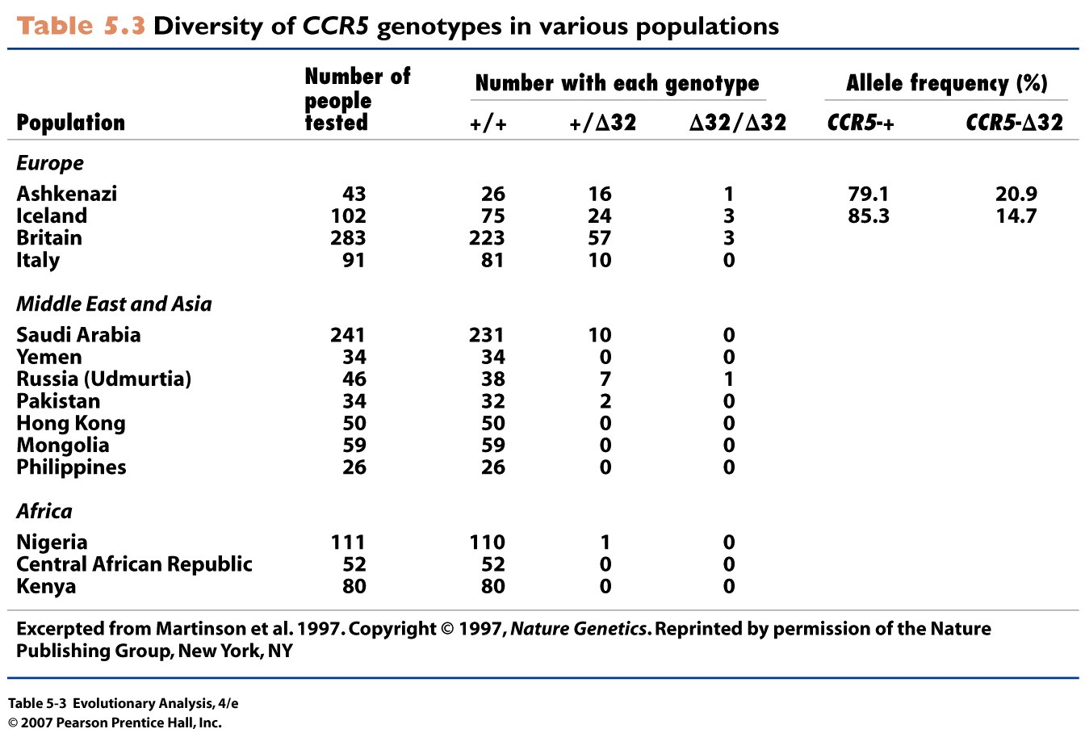
16/43= 0.37 (Hets)
F(D³²)=
16 + 2x1 = 18
18/86= 0.21
Notes:
Table 5.3 Diversity of CCR5 genotypes in various populations

Slide 43
Conclusion
Mutation rates are high
Mutations effect fitness
Mutations contribute to genetic variation
Duplications can lead to new gene function
Inversions can protect adaptations
Polyploidy can result in instant speciation
Mutations are important to evolution
Notes:
Mutations source of new variation. Without natural selection adaptations would not evolve. See next lecture.

